Slide 1
Transportation Problem
Transportation problem is a special kind of Linear Programming Problem (LPP) in which goods are transported from a set of sources to a set of destinations subject to the supply and demand of the sources and destination respectively such that the total cost of transportation is minimized. It is also sometimes called as Hitchcock problem.
Types of Transportation problems:
Balanced: When both supplies and demands are equal then the problem is said to be a balanced transportation problem.
Unbalanced: When the supply and demand are not equal then it is said to be an unbalanced transportation problem. In this type of problem, either a dummy row or a dummy column is added according to the requirement to make it a balanced problem. Then it can be solved similar to the balanced problem.

Slide 2
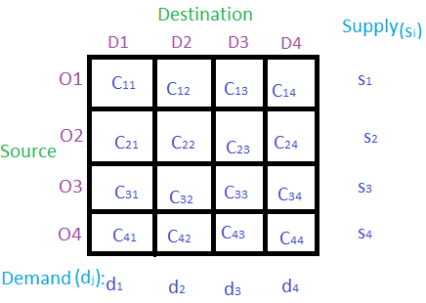
Basic structure of transportation problem:
In the given table
D1, D2, D3 and D4 are the destinations where the products/goods are to be delivered from different sources S1, S2, S3 and S4.
S_{i} is the supply from the source O_{i}.
d_{j} is the demand of the destination D_{j}.
C_{ij} is the cost when the product is delivered from source S_{i} to destination D_{j}.

Slide 3
Methods to Solve:
To find the initial basic feasible solution there are three methods:
NorthWest Corner Cell Method.
Least Call Cell Method.
Vogel’s Approximation Method (VAM).

Slide 4
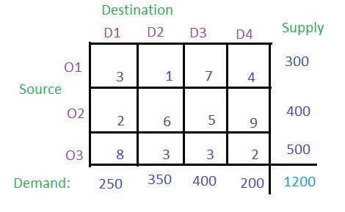
NorthWest Corner Method
Given three sources O1, O2 and O3 and four destinations D1, D2, D3 and D4. For the sources O1, O2 and O3, the supplyis 300, 400 and 500 respectively. The destinationsD1,D2, D3 and D4 have demands 250, 350, 400 and 200 respectively.

Slide 5
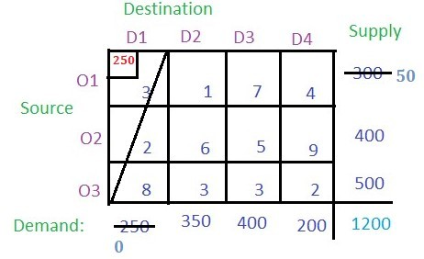
NorthWest Corner Method
(O1, D1) has to be the starting point i.e. the north-west corner of the table. Each and every value in the cell is considered as the cost per transportation. Compare the demand for column D1 and supply from the source O1 and allocate the minimum of two to the cell (O1, D1) as shown in the figure.
The demand for Column D1 is completed so the entire column D1 will be canceled. The supply from the source O1 remains 300 – 250 = 50.

Slide 6
NorthWest Corner Method

Slide 7
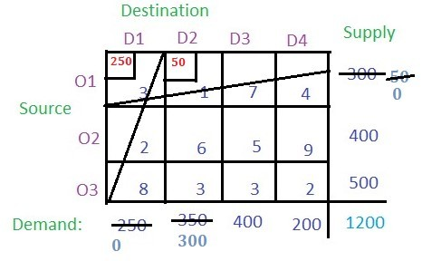
NorthWest Corner Method
From the remaining table the north-west corner cell is (O2, D2). The minimum among the supply from source O2 (i.e 400) and demand for column D2 (i.e 300) is 300,
so allocate 300 to the cell (O2, D2). The demand for the column D2 is completed so cancel the column and the remaining supply from source O2 is 400 – 300 = 100.

Slide 8
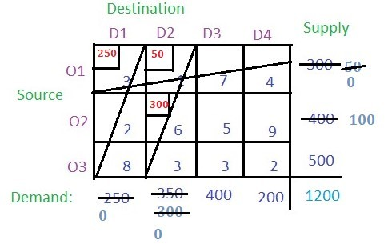
NorthWest Corner Method

Slide 9
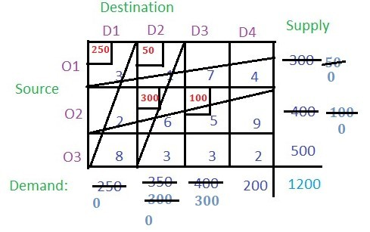
NorthWest Corner Method
Now from remaining table find the north-west corner i.e. (O2, D3) and compare the O2 supply (i.e. 100) and the demand for D2 (i.e. 400) and allocate the smaller (i.e. 100) to the cell (O2, D2).
The supply from O2 is completed so cancel the row O2. The remaining demand for column D3 remains
400 – 100 = 300.

Slide 10
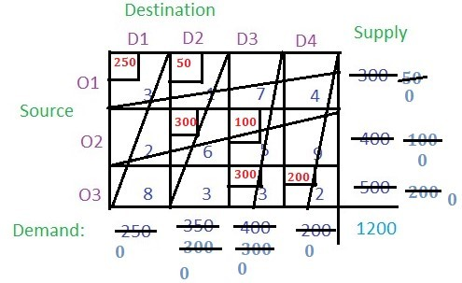
Proceeding in the same way, the final values of the cells will be :

Slide 11
NorthWest Corner Method
In the last remaining cell the demand for the respective columns and rows are equal which was cell (O3, D4). In this case, the supply from O3 and the demand for D4 was 200 which was allocated to this cell. At last, nothing remained for any row or column.
Now just multiply the allocated value with the respective cell value (i.e. the cost) and add all of them to get the basic solution i.e. (250 * 3) + (50 * 1) + (300 * 6) + (100 * 5) + (300 * 3) + (200 * 2) = 4400

Slide 12
Least Cost Cell Method

Slide 13
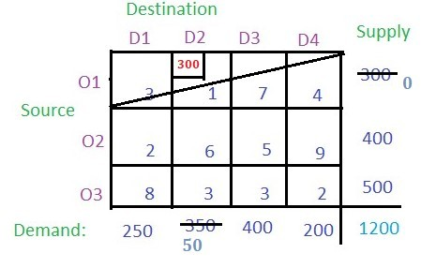
Least Cost Cell Method
According to the Least Cost Cell method, the least cost among all the cells in the table has to be found which is 1 (i.e. cell (O1, D2)).
Now check the supply from the row O1 and demand for column D2 and allocate the smaller value to the cell. The smaller value is 300 so allocate this to the cell.
The supply from O1 is completed so cancel this row and the remaining demand for the column D2 is 350 – 300 = 50.

Slide 14
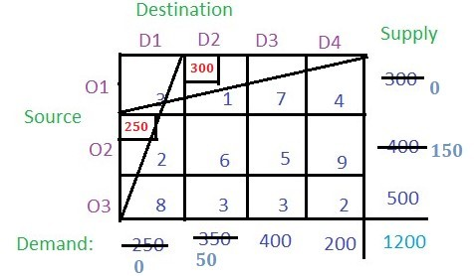
Least Cost Cell Method
Now find the cell with the least cost among the remaining cells. There are two cells with the least cost i.e. (O2, D1) and (O3, D4) with cost 2. Lets select (O2, D1). Now find the demand and supply for the respective cell and allocate the minimum among them to the cell and cancel the row or column whose supply or demand becomes 0 after allocation.

Slide 15
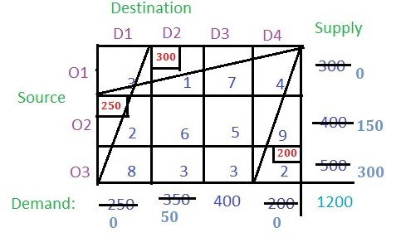
Least Cost Cell Method
Now the cell with the least cost is (O3, D4) with cost 2. Allocate this cell with 200 as the demand is smaller than the supply. So the column gets cancelled.

Slide 16
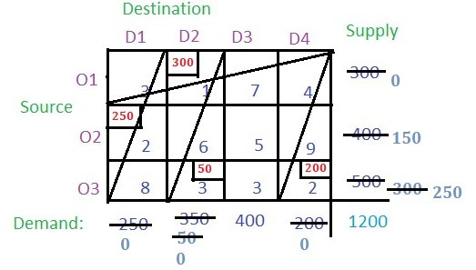
Least Cost Cell Method
There are two cells among the unallocated cells that have the least cost. Choose any at random say (O3, D2). Allocate this cell with a minimum among the supply from the respective row and the demand of the respective column. Cancel the row or column with zero value.

Slide 17
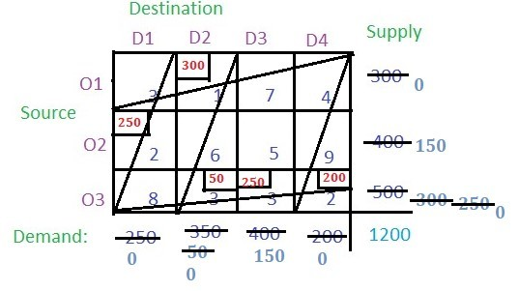
Least Cost Cell Method
Now the cell with the least cost is (O3, D3). Allocate the minimum of supply and demand and cancel the row or column with zero value.

Slide 18
Least Cost Cell Method
The only remaining cell is (O2, D3) with cost 5 and its supply is 150 and demand is 150 i.e. demand and supply both are equal. Allocate it to this cell.

Slide 19
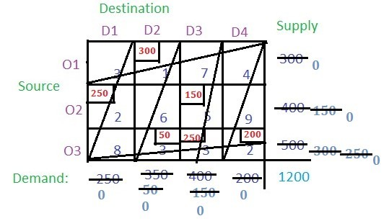
Least Cost Cell Method

Slide 20
Least Cost Cell Method
Now multiply the cost of the cell with their respective allocated values and add all of them to get the basic solution
i.e. (300 * 1) + (250 * 2) + (150 * 5) + (50 * 3) + (250 * 3) + (200 * 2) = 2850

Slide 21
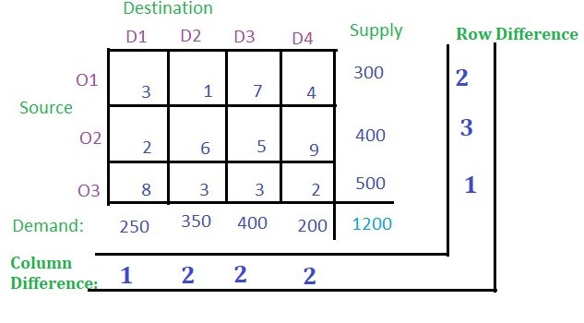
Vogel’s Approximation Method

Slide 22
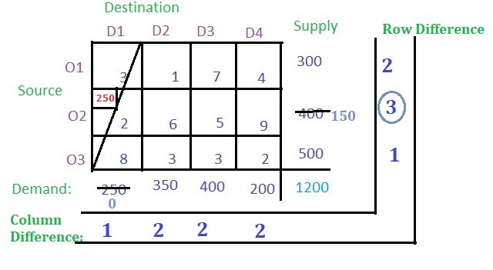
Vogel’s Approximation Method

Slide 23
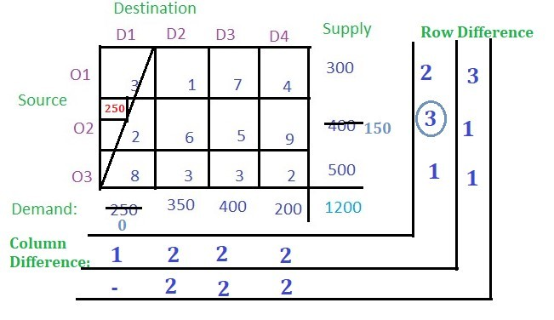
Vogel’s Approximation Method

Slide 24
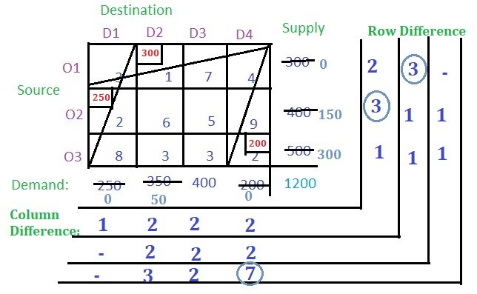
Vogel’s Approximation Method

Slide 25
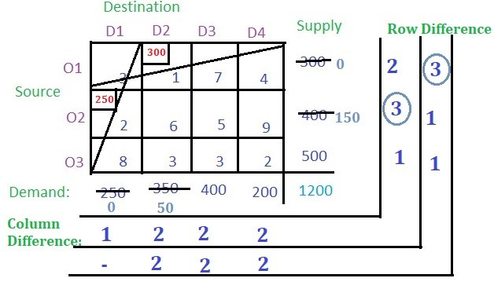
Vogel’s Approximation Method

Slide 26
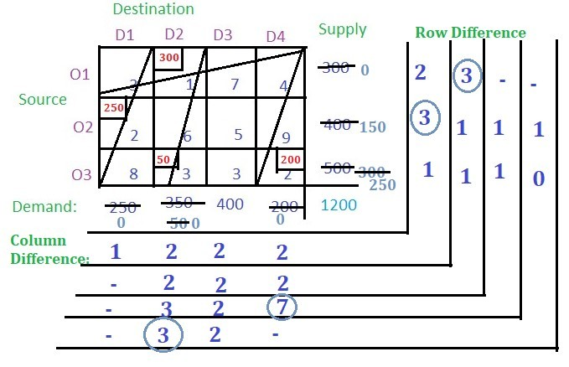
Vogel’s Approximation Method

Slide 27
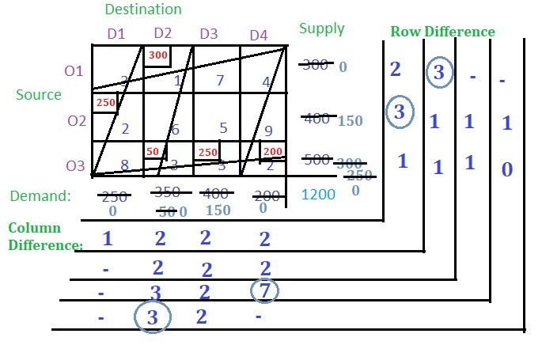
Vogel’s Approximation Method

Slide 28
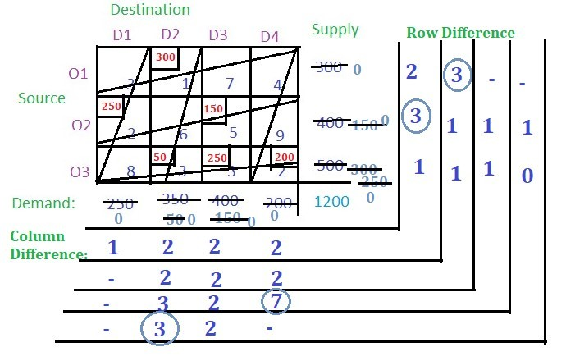
Vogel’s Approximation Method

Slide 29
Vogel’s Approximation Method
No balance remains. So multiply the allocated value of the cells with their corresponding cell cost and add all to get the final cost
i.e. (300 * 1) + (250 * 2) + (50 * 3) + (250 * 3) + (200 * 2) + (150 * 5) = 2850

